Slide 1
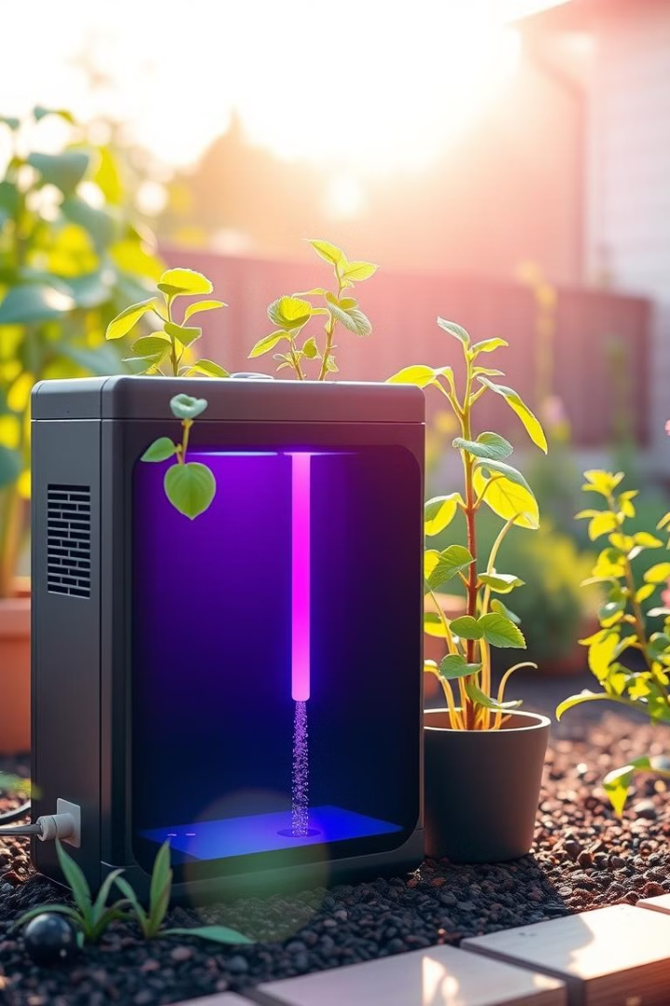
Automated Plant Watering System
Welcome to the presentation for our innovative automated plant watering system. This system is designed to provide your plants with the perfect amount of water, ensuring their optimal health and growth. This presentation will walk you through the system's design, functionality, and benefits.
1
K. Nadini (192211538)
2
R. Malleswari (192211434)

Slide 2




Soil Moisture Monitoring
Sensor Placement
Data Acquisition
Moisture Thresholds
The system utilizes a soil moisture sensor to measure the water content in the soil. This sensor is strategically placed in the plant's pot, enabling real-time monitoring of soil moisture levels.
The sensor transmits data to a microcontroller, providing accurate and continuous measurements of soil moisture levels. This data is crucial for determining when watering is necessary.
We've established moisture thresholds for different types of plants. These thresholds define the ideal moisture levels for each plant, ensuring they receive the right amount of water.

Slide 3
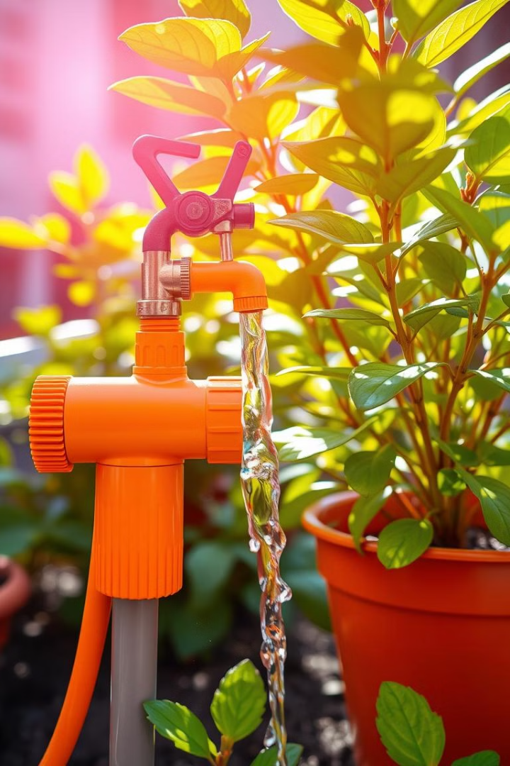



Water Pump Activation
Moisture Level Check
The microcontroller constantly monitors the soil moisture levels received from the sensor.
Threshold Comparison
When the moisture level falls below the pre-defined threshold for the specific plant, the microcontroller triggers the water pump.
Pump Activation
The water pump is activated, delivering the necessary amount of water to the plant, restoring the optimal moisture level.

Slide 4
C++ Application Development
Microcontroller Communication
Threshold Management
User Interface
The C++ application stores the moisture thresholds for different plant types, allowing customization for individual plant needs. This ensures optimal watering for a diverse range of plants.
The application provides a user-friendly interface for monitoring plant moisture levels, adjusting settings, and viewing watering schedules. This allows users to stay informed and take control of the system.
The C++ application serves as the brain of the system, establishing communication with the microcontroller. It receives soil moisture data, interprets it, and controls the water pump accordingly.

Slide 5
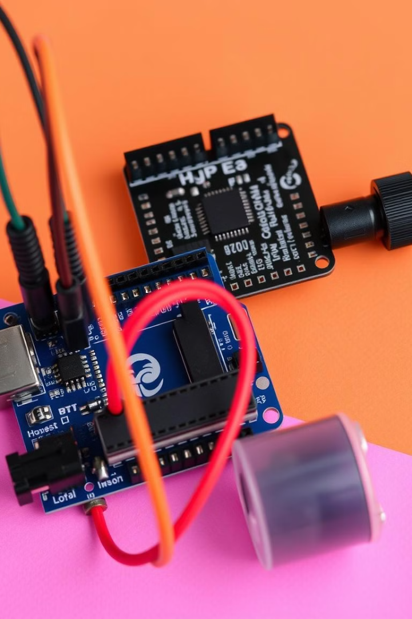
Microcontroller Integration
Task
Microcontroller Role
Data Acquisition
Receives moisture data from the soil sensor
Threshold Comparison
Compares moisture data with pre-defined thresholds
Pump Control
Activates or deactivates the water pump based on moisture levels
Communication
Communicates with the C++ application for data exchange

Slide 6
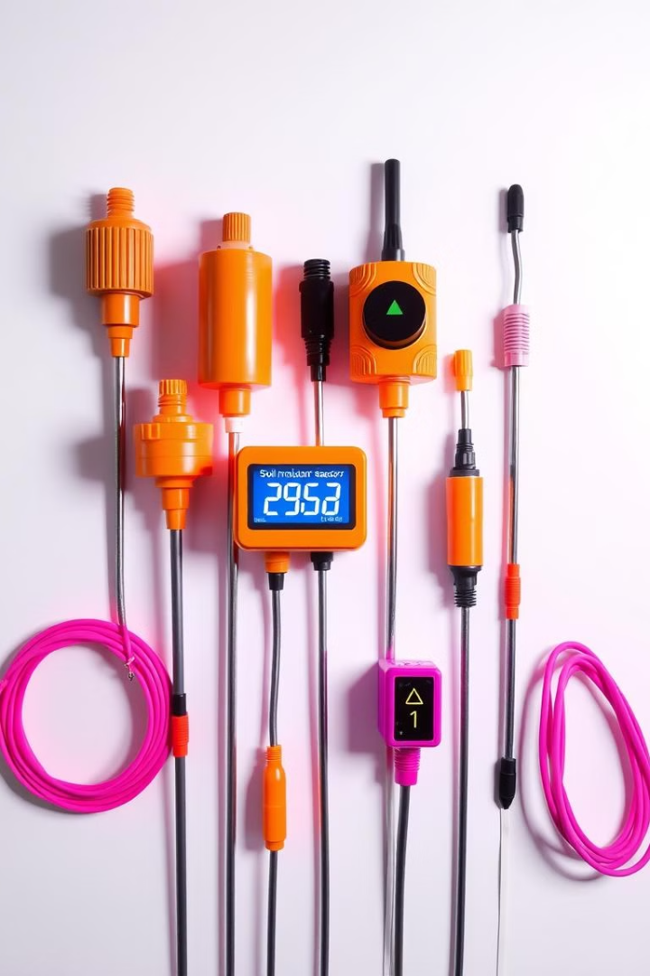
About Sensor Type and Features
1
Capacitive Sensors
2
Resistive Sensors
These sensors measure the capacitance of the soil, which changes with moisture levels. They are generally affordable and provide accurate readings.
These sensors measure the electrical resistance of the soil, which changes with moisture levels. They are known for their reliability and long lifespan.
3
Analog to Digital Conversion (ADC)
The sensors produce an analog signal that needs to be converted to a digital signal for the microcontroller to interpret. We use an ADC module for this conversion.

Slide 7
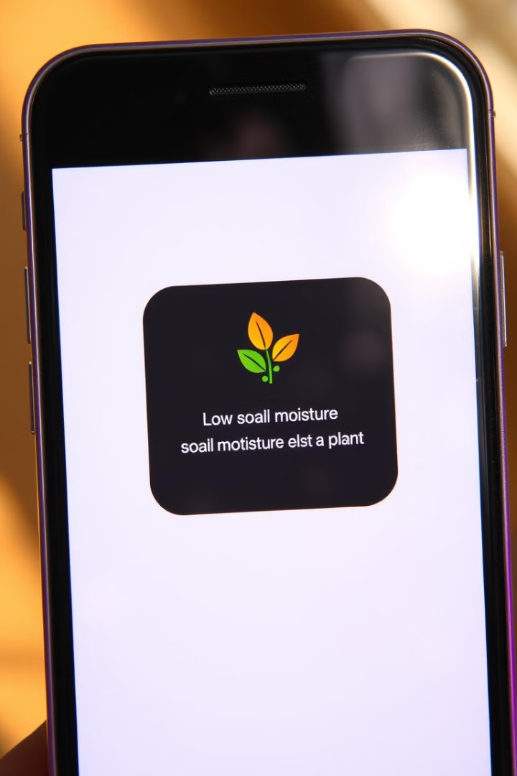
Monitoring and Notification
1
Moisture Monitoring
The system continuously monitors soil moisture levels and sends real-time data to the C++ application.
2
Notification Trigger
If the moisture level falls below the threshold for a specific plant, the application triggers a notification.
3
Notification Delivery
The notification is delivered to the user's smartphone or computer, providing timely alerts about watering needs.

Slide 8
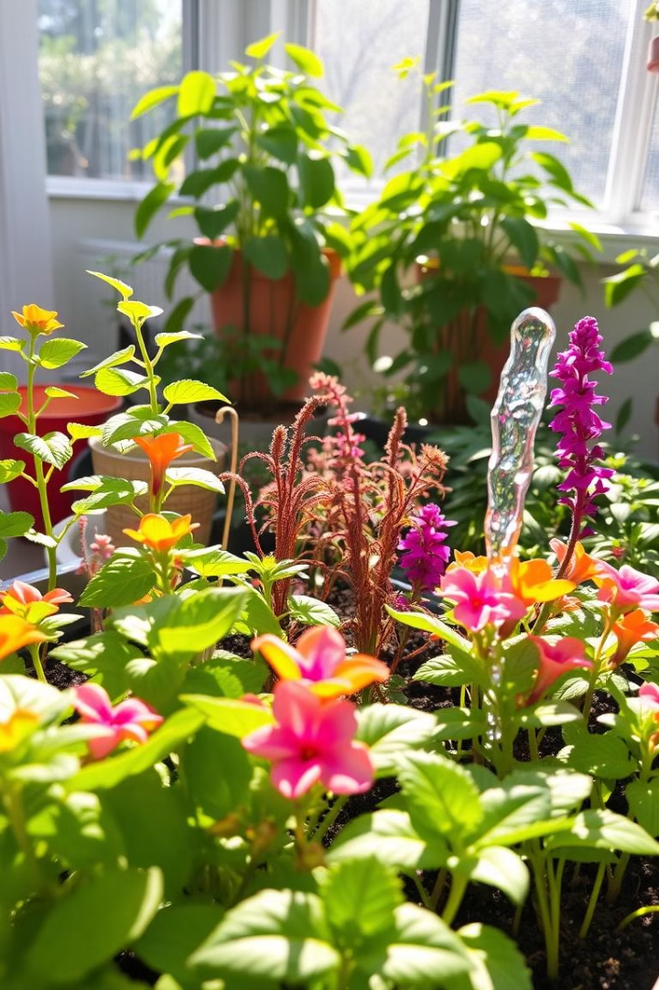
Benefits
Optimized Watering
Convenience and Flexibility
The system ensures that plants receive the perfect amount of water, preventing overwatering or underwatering, leading to healthier and more vibrant plants.
The system eliminates the need for manual watering, freeing up your time and allowing you to enjoy your garden without worry. You can easily adjust settings for different plant types.
Water Conservation
The system precisely delivers the right amount of water, minimizing water waste and promoting sustainable gardening practices.

Slide 9

Conclusion
The C++ application has been successfully developed and integrated with the microcontroller. The system is now ready for deployment and will provide automatic watering for our plants.

Slide 10
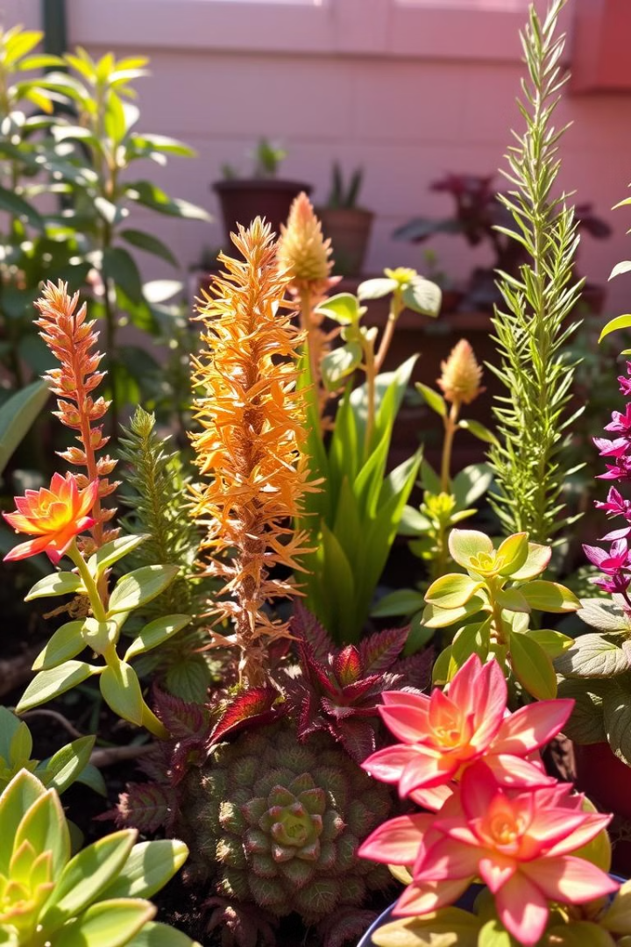
Thank You
Thank you for your time. We believe this automated plant watering system is a game changer for any gardener who values convenience, efficiency, and the health of their plants. Feel free to ask any questions you may have.

